Slide 1

Movie Recommendation System
A content-based movie recommendation system uses the features and attributes of films, such as genre, director, actors, and plot, to suggest new movies that are similar to ones a user has enjoyed in the past. This approach focuses on the intrinsic properties of the movies themselves.

Slide 2
Team Members
K.DURGA PRASAD
M.PRANAY SANKAR
D.BHANU
K.HARIKA SRI
CH.V ADITHYA

Slide 3
Introduction to Recommendation Systems:
Personalization
Discover New Content
Improved Engagement
Recommendation systems analyze user preferences and behaviors to provide customized suggestions.
These systems help users find relevant movies, shows, products, or services they may not have discovered on their own.
Relevant recommendations increase the likelihood that users will engage with and enjoy the suggested content.

Slide 4

Abstract
Content-Based Approach
User Profiles
This system recommends movies based on their intrinsic features, such as genre, director, and actors.
The system creates user profiles by analyzing their viewing history and preferences.
Similarity Matching
Movies are recommended based on their similarity to the user's favorite films.

Slide 5

Objectives of a Movie Recommendation System
1
Accurate Suggestions
2
Diversity
Provide movie recommendations that closely match the user's tastes and preferences.
Introduce users to a variety of movies they may not have discovered on their own.
3
Improved User Experience
Enhance the overall movie discovery and selection process for the user.

Slide 6
Previous Projects based on this:
MovieLens - A popular open-source movie recommendation system that allows users to rate and receive recommendations based on collaborative filtering.
Netflix Recommendation System - Netflix's proprietary algorithm that uses a combination of collaborative and content-based filtering to suggest titles a user is likely to enjoy.
IMDb Recommendation Engine - IMDb's recommendation system that provides personalized suggestions based on a user's viewing history and ratings.
Rotten Tomatoes Movie Recommender - A content-based system that suggests movies based on user preferences and critical reviews.

Slide 7

Reference
1
Academic Literature
2
Industry Best Practices
The system's design and implementation is based on research from peer-reviewed publications.
Real-world examples and case studies from leading companies in the movie industry.
3
Continuous Improvement
The system incorporates feedback and updates to enhance its recommendation accuracy over time.

Slide 8

Requirements
Movie Database
User Profiles
A comprehensive database of movie metadata, including titles, descriptions, genres, and cast information.
The ability to create and maintain user profiles based on their viewing history and preferences.
Recommendation Algorithm
A content-based algorithm that can analyze movie features and user data to provide personalized recommendations.

Slide 9

Methodology
Data Acquisition
Gather relevant movie data and user preferences from various sources.
Similarity Calculation
Determine the similarity between movies based on their features.
1
2
3
Feature Extraction
Analyze and extract meaningful attributes from the movie data.

Slide 10
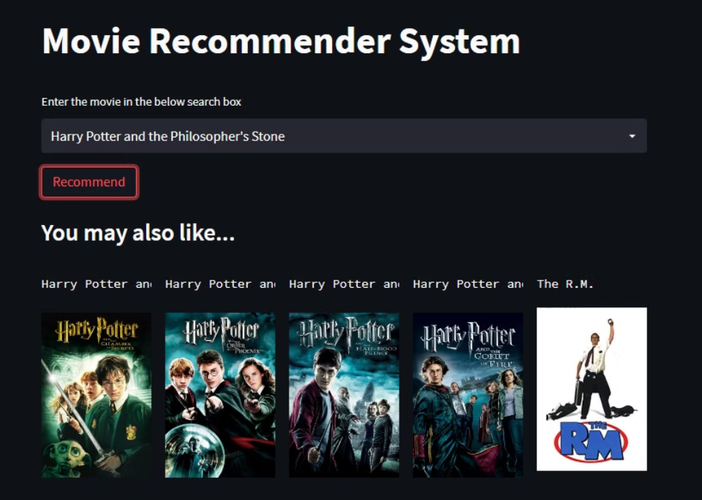



Output
Movie Recommendations
Personalized Experience
Discovery of New Movies
The system presents a list of movie suggestions based on the user's preferences.
Recommendations are tailored to each individual user's tastes and viewing history.
The system introduces users to movies they may not have found on their own.

Slide 11

Advantages and Disadvantages
Advantages
Disadvantages
Our movie recommendation system offers personalized suggestions tailored to each user's preferences, helping them discover new films they're likely to enjoy. It leverages advanced machine learning algorithms to analyze user data and movie metadata, providing accurate and relevant recommendations.
The system requires a large and comprehensive movie database to ensure accurate recommendations. Maintaining and updating this database can be resource-intensive. User privacy concerns may arise as the system collects and analyzes user data to generate personalized suggestions.

Slide 12




Conclusion
Improved User Experience
Increased Engagement
Competitive Advantage
The content-based recommendation system enhances the movie discovery process for users.
Relevant recommendations lead to higher user engagement and satisfaction with the platform.
Effective movie recommendations can provide a strategic advantage for entertainment platforms.

Slide 13

Thank you!

